Slide 1

END TO END PYTHON + SQL PRJOJECT

Slide 2

Objective
This project is an end-to-end data analysis solution designed to extract critical business insights from Walmart sales data.
We utilize Python for data processing and analysis, SQL for advanced querying, and structured problem-solving techniques to solve key business questions.
The project is ideal for data analysts looking to develop skills in data manipulation, SQL querying, and data pipeline creation

Slide 3

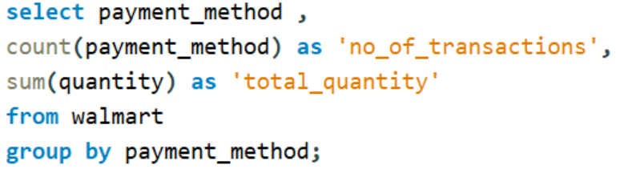
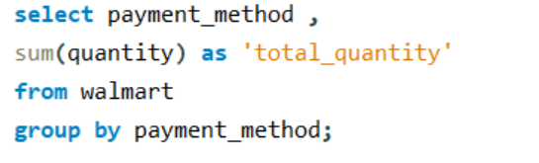
Q1: Find different payment methods, number of transactions, and quantity sold by payment method
Q2: Calculate the total quantity of items sold per payment method

Slide 4
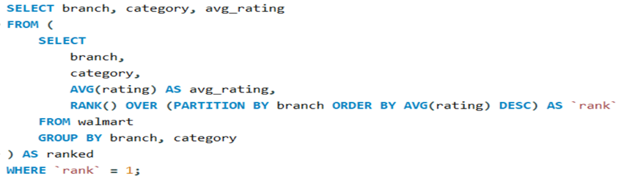
Q3:Identify the highest-rated category in each branch Display the branch, category, and avg rating

Slide 5
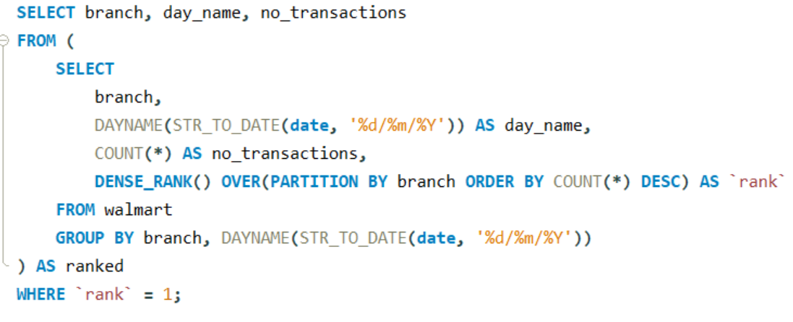
Q4: Identify the busiest day for each branch based on the number of transactions

Slide 6
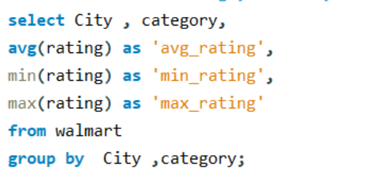
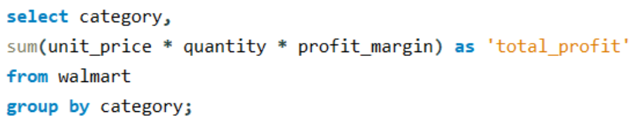
Q5: Determine the average, minimum, and maximum rating of categories for each city
Q6: Calculate the total profit for each category

Slide 7
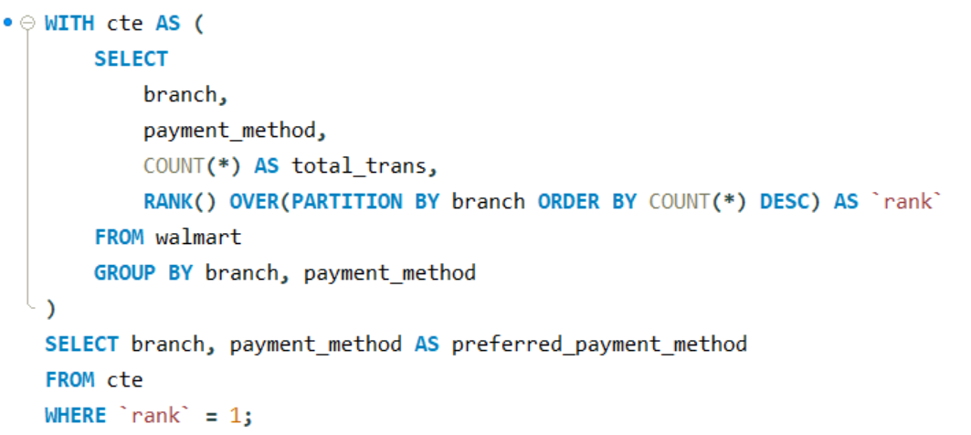
Q7: Determine the most common payment method for each branch

Slide 8
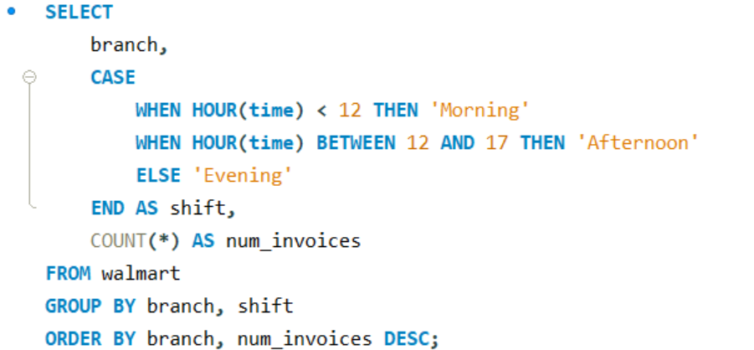
Q8: Categorize sales into Morning, Afternoon, and Evening shifts

